Slide 1
Longest Common Subsequence

Slide 2
Subsequences
Suppose you have a sequence
X = < x₁,x₂,…,x_{m}>
of elements over a finite set S.
A sequence Z = < z₁,z₂,…,z_{k}> over S is called a subsequence of X if and only if it can be obtained from X by deleting elements.

Slide 3
Common Subsequences
Suppose that X and Y are two sequences over a set S.
We say that Z is a common subsequence of X and Y if and only if
Z is a subsequence of X
Z is a subsequence of Y

Slide 4
The Longest Common Subsequence Problem
Given two sequences X and Y over a set S, the longest common subsequence problem asks to find a common subsequence of X and Y that is of maximal length.

Slide 5
LCS
For instance,
Sequence 1: president
Sequence 2: providence
Its LCS is priden.
president
providence

Slide 6
LCS
        Another example:
Sequence 1: algorithm
Sequence 2: alignment
One of its LCS is algm.
a l g o r i t h m
a l i g n m e n t

Slide 7
Naïve Solution
Let X be a sequence of length m,
and Y a sequence of length n.
Check for every subsequence of X whether it is a subsequence of Y, and return the longest common subsequence found.
There are 2^{m} subsequences of X. Testing a sequences whether or not it is a subsequence of Y takes O(n) time. Thus, the naïve algorithm would take O(n2^{m}) time.

Slide 8
Divide and Conquer
Can we use divide-and-conquer to solve this problem?

Slide 9
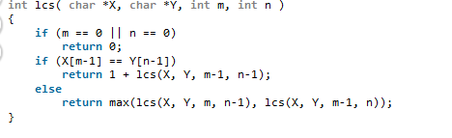

Slide 10
Dynamic Programming
Let us try to develop a dynamic programming solution to the LCS problem.

Slide 11
LCS Notation
Let X and Y be sequences.
We denote by LCS(X, Y) the set of longest common subsequences of X and Y.

Slide 12
Overlapping Subproblems
If x_{m} = y_{n} then we solve the subproblem to find an element in LCS(X_{m-1} , Y_{n-1} ) and append x_{m}
If x_{m} <> y_{n} then we solve the two subproblems of finding elements in LCS(X_{m-1} , Y_{n-1} ) and LCS(X_{m-1} , Y_{n-1} ) and choose the longer one.

Slide 13
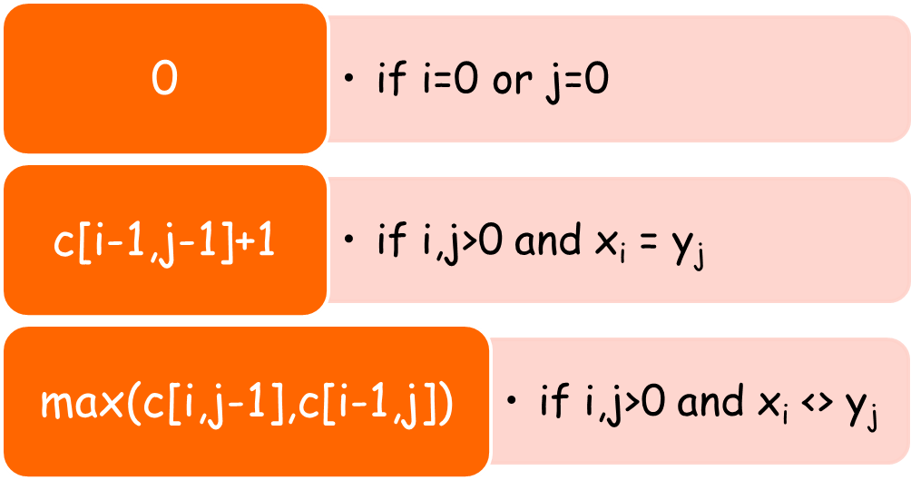
Let X and Y be sequences.
Let c[i,j] be the length of an element in LCS(X_{i}, Y_{j}).
c[i,j] =

Slide 14
Longest Common Subsequence (LCS)
A subsequence of a sequence/string S is obtained by deleting zero or more symbols from S. For example, the following are some subsequences of “president”: pred, sdn, predent. In other words, the letters of a subsequence of S appear in order in S, but they are not required to be consecutive.
The longest common subsequence problem is to find a maximum length common subsequence between two sequences.

Slide 15
LCS
For instance,
Sequence 1: president
Sequence 2: providence
Its LCS is priden.
president
providence

Slide 16
LCS
        Another example:
Sequence 1: algorithm
Sequence 2: alignment
One of its LCS is algm.
a l g o r i t h m
a l i g n m e n t

Slide 17
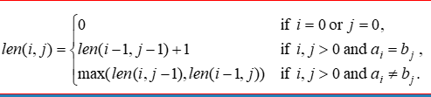
How to compute LCS?
Let A=a₁a₂…a_{m} and B=b₁b₂…b_{n} .
len(i, j): the length of an LCS between
a₁a₂…a_{i} and b₁b₂…b_{j}
With proper initializations, len(i, j) can be computed as follows.

Slide 18
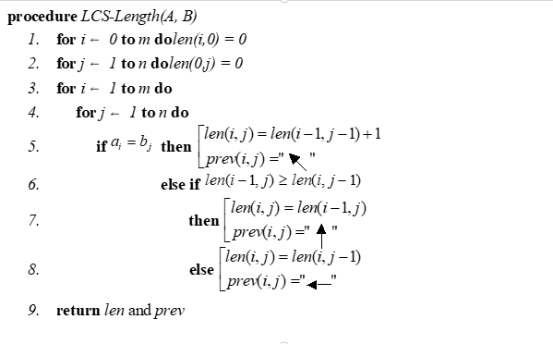

Slide 19
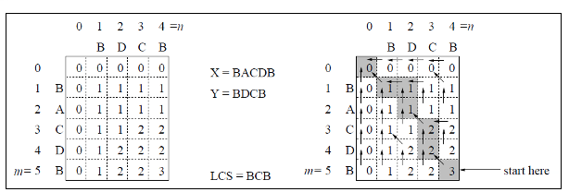

Slide 20
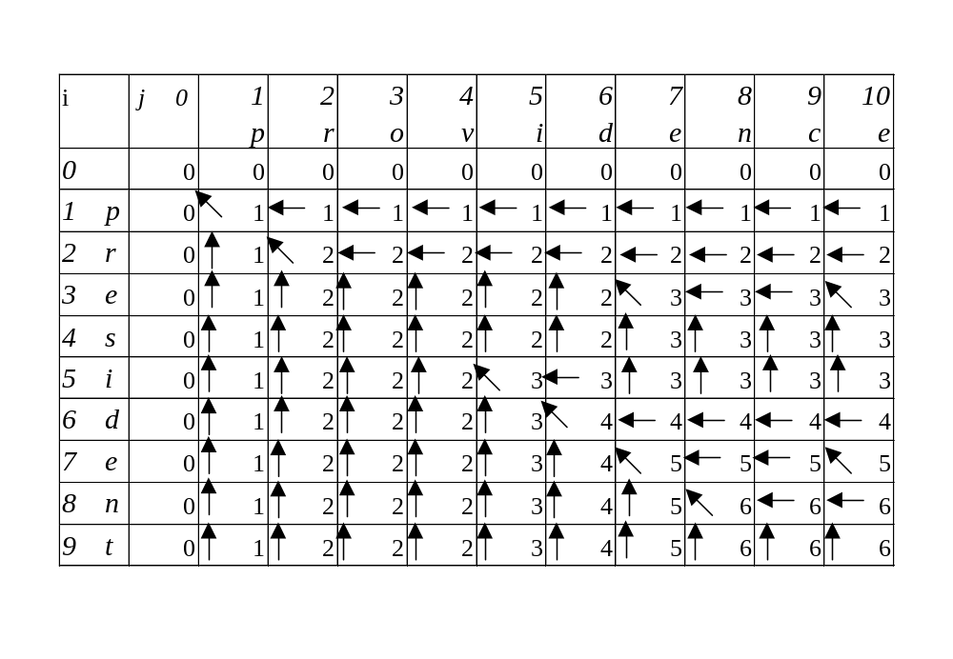
Running time and memory: O(mn) and O(mn).

Slide 21
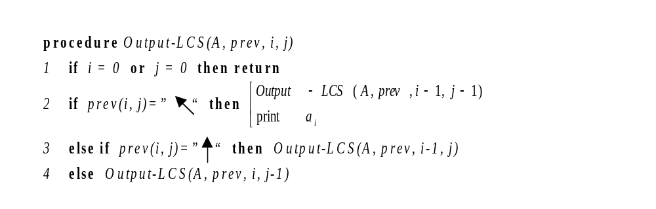
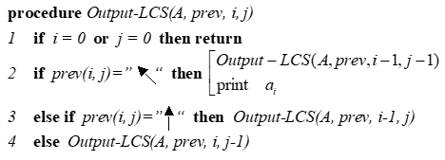
The backtracing algorithm

Slide 22
